Slide 1
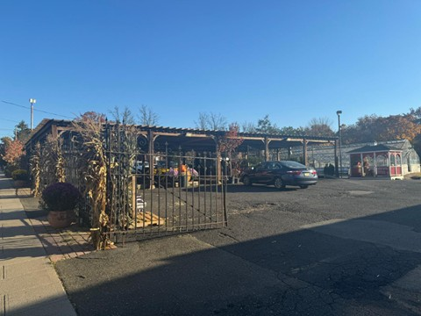

383 Bloomfield Avenue Redevelopment Plan
Township of Verona
Planning Board Meeting
Date: October 23, 2025

Slide 2









LRHL Redevelopment Process
Municipal Council authorizes Planning Board by Resolution to conduct AINR Study for specific properties.
Planning Board conducts Study. Holds duly noticed public hearing.
Municipal Council accepts the Planning Board’s Recommendation and designates the areas in need of redevelopment and rehabilitation by Resolution. Authorizes the preparation of a Redevelopment Plan.
Municipal Council introduces the ordinance to adopt the Redevelopment Plan.
Role of the Planning Board is advisory and checks for consistency with the Master Plan.
Municipal Council adopts the Redevelopment Plan or may amend/revise any portion by an affirmative vote of the full majority. The Redevelopment Plan is an ordinance.
Redevelopment Agency/Municipal Council select/designate a Redeveloper and negotiates the Redeveloper Agreement.
The Redeveloper submits a Site Plan Submission to the Planning Board for approval, in accordance with Redevelopment Plan.
Current Step
Next Step
Future Next Steps

Slide 3
Redevelopment / rehabilitation
Three Step Process
Step 1
Conducted AINR Study to see if area meets statutory criteria.
Established Area in Need of Redevelopment on February 3, 2025, via Resolution 2025-049.
NO EMINENT DOMAIN
Step 2
Prepare & adopt Redevelopment Plan
Step 3
Select a Redeveloper or work with existing property owners
Redeveloper obtains site plan approval
Negotiate the redevelopment agreement
Implement the Plan
Process governed by:
Local Redevelopment & Housing Law
NJSA 40A:12A-1 et. sec.
Notes:
Bloomfield Avenue corridor designated as a Rehabilitation Area on March 11, 2024, via Resolution 2024-75.

Slide 4
Planning Goals and Objectives, including the plan’s relationship to local objectives regarding land uses, density, transportation, public utilities, recreation and community facilities, and other public improvements.
Description and Analysis of Concept Plan(s), including proposed land uses, and building requirements.
The plan's relationship to the development regulations of the municipality.
The plan’s relationship to master plans of contiguous municipalities, the county master plan, and the state development and redevelopment plan.
Procedures for amending the plan.
Redevelopment Plan Requirements
(N.J.S.A: 40A:12A-7)

Slide 5
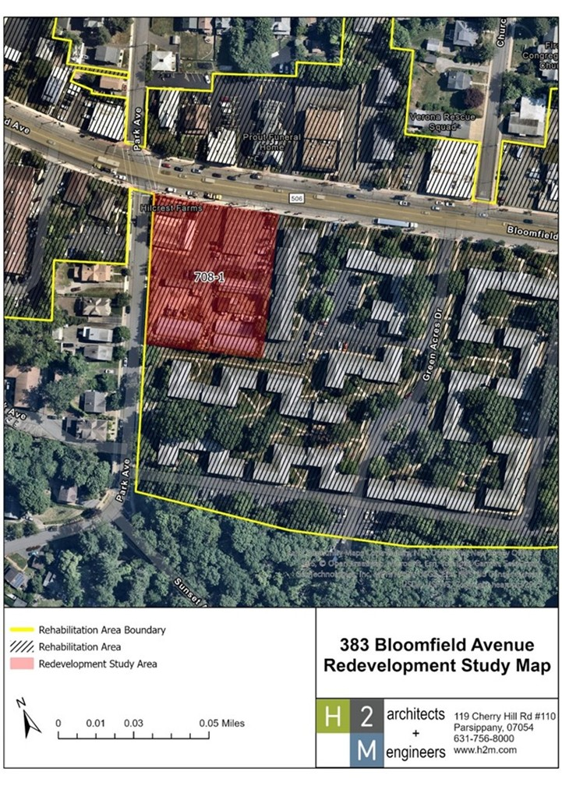
Redevelopment & Rehabilitation area

Slide 6
Redevelopment Vision
PROMOTE
ENHANCE
IMPROVE
DIVERSIFY
Investment and economic vitality by encouraging mixed use commercial and residential development.
Enhance and maintain the character of the Township by incorporating contemporary planning and design principles.
Utilize sustainable development principles to improve stormwater management and overall sustainability.
Provide a range of market rate and affordable housing options that meet the current and future needs of Township residents.
REVITALIZE
CREATE
An obsolete and underutilized area of the Township with high-quality development.
Encourage walkability and public transit use and minimize vehicular dependency.

Slide 7
Introduction
Existing Conditions
Definitions
Use and Bulk Regulations
Building and Site Design
Plan Consistency
Plan Implementation
Redevelopment plan outline

Slide 8
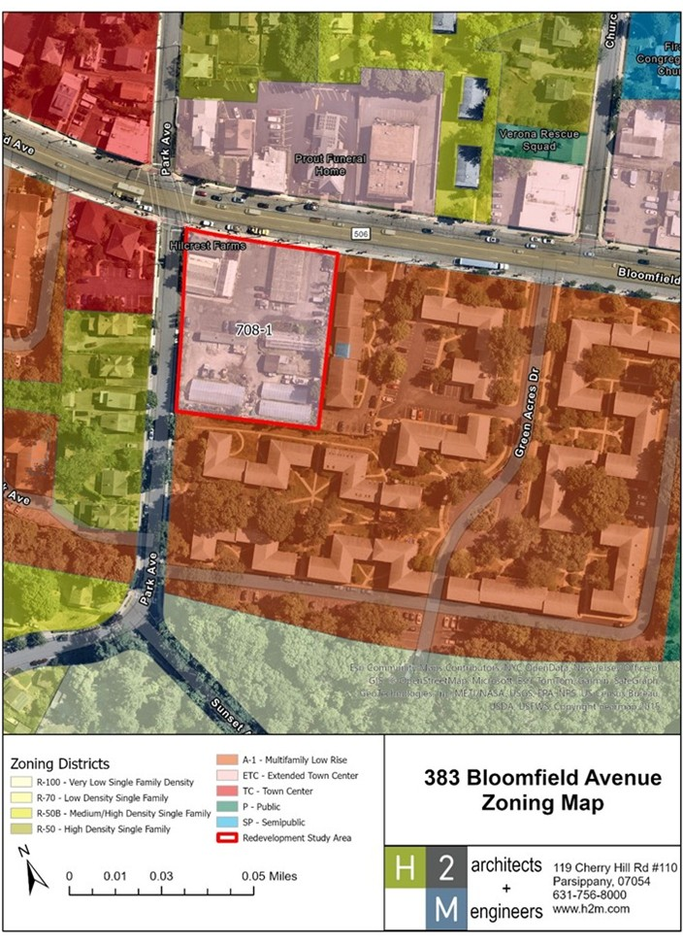
Redevelopment area

Slide 9
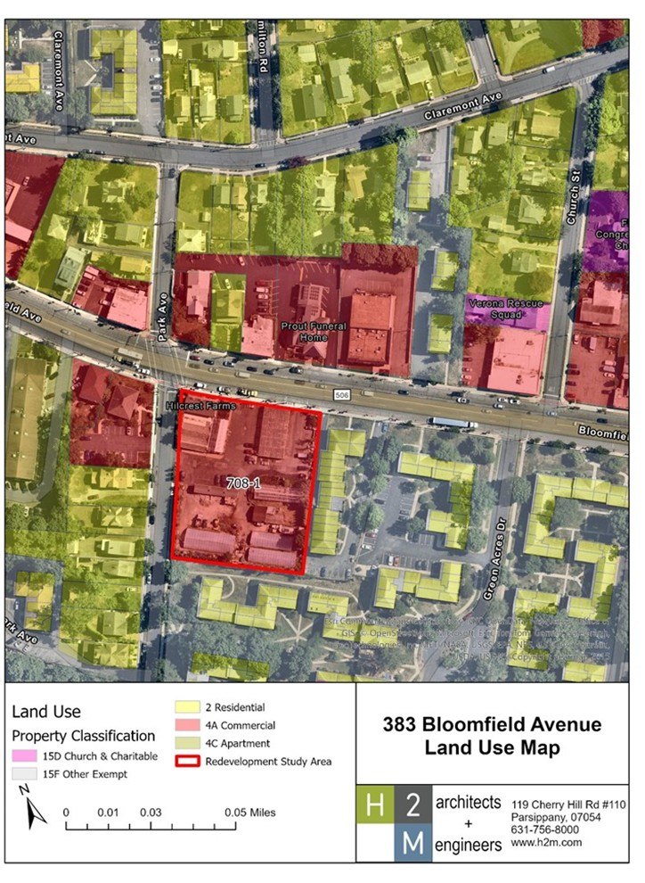
Redevelopment area Land Use

Slide 10
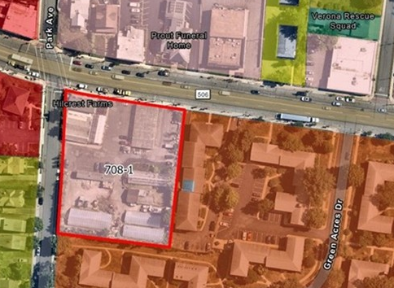
Use and bulk standards
Uses
Dwelling Units above the ground floor
Art Gallery
Art Studio
Artisanal Workshop
Brewpub
Commercial Office Use
Learning Center
Personal Services
Restaurants
Retail Sales
Retail Services
Any combination of the above-listed uses.
Bulk Standards | Requirements
Min. Lot Area | 1 acre
Max Density | 27 dwelling units/acre
Min Lot Width | 210 ft
Min. Front Yard Setback (Bloomfield Avenue) | 10 ft
Min. Front Yard Setback (Park Avenue) | 20 ft.
Min. Side Yard Setback | 30 ft
Rear Yard Setback | 30 ft
Max. Building Coverage | 40%
Max. Impervious coverage (%) | 80%
Max Building Height (stories/feet) | 4 stories*/ 50 ft
*4 stories following the change in topography from Bloomfield towards the rear property line along Park Avenue with the fourth floor stepped back

Slide 11
Building and Unit Design:
  Dwelling unit standards: Section 4.4 in terms of bedrooms, size, and affordable housing standards.
  Central air conditioning and laundry facilities in the unit.
Driveway and Curb Standards: Section 4.5 in terms of driveway access, driveway & median width, and curbs.
Parking Standards:
  Parking prohibited in front yard and permitted underneath building
  One Loading Space to be provided
  Parking standards for residential apartments, special needs housing, and non-residential uses
On-site Pedestrian Requirements
Signage/Awning Standards
Design standards

Slide 12
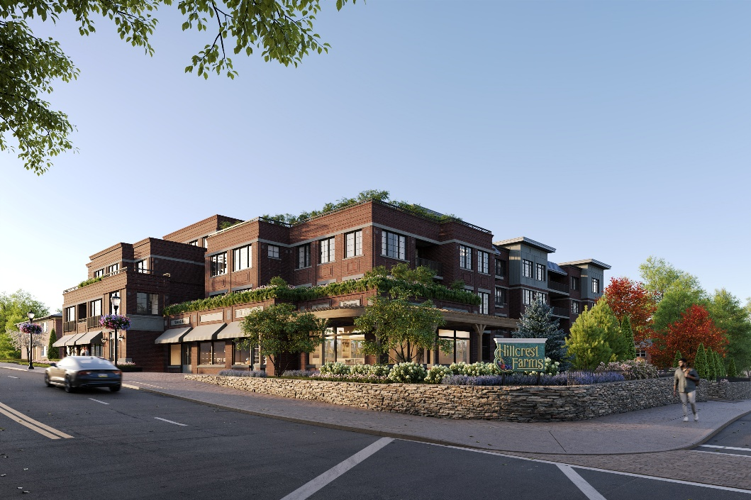
Architectural and Residential Standards:
  Dwelling unit mix and privacy
  Site layout
  Lighting
  Safety
Building materials
  Brick, stone, metal panels or siding, fiber-cement lap siding, fiber-cement shingles, clapboard or synthetic alternative, wood or architectural metal individually and in combination.
  Natural materials encouraged
  No blank facades and buildings shall adhere to the standards listed in the redevelopment plan.
Buffers
  Minimum 15-foot landscaped buffer
  Located within 10 feet of the property line
  Visual screening consisting of evergreen hedges/shrubs and a six-foot privacy fence
Building and site design

Slide 13
Façade design standards
Fenestration
Roofs
Screening for mechanical equipment
Trash/Trash Enclosures/Recycling
Utilities
Lighting
Building and site design

Slide 14
Stormwater Management Rules
  As per the pertinent Township ordinances
Sustainability
  Required:
    Landscaping
    Water Management and Recycling
  Encouraged :
    Energy Efficiency
    Indoor Air Quality
    Water Efficiency
Building and site design

Slide 15
Relationship to Master Plans
  Verona Master Plan
  Adjacent Municipalities
  2001 State Development and Redevelopment Plan
  2025 State Development and Redevelopment Plan
PLAN CONSISTENCY

Slide 16
Thank you!

